Slide 1



The Telecom Regulatory Authority TELECOM CHURN REPORT
Name-Simmi
Enrollment ID-EN12024077913

Slide 2
Business Objective
TRAI(The Telecom Regulatory Authority) Wants to Identify the Key Factors who leads customers to churn , TRAI want to know which company has the highest churn rate. so that TRAI can give new strategies to company to reduce churn rate.
Dataset Taken from -
https://t.ly/8le2a

Slide 3
1.Requirements
2.Univariate Analysis
Agenda
3.Bivariate Analysis
4.Tableau Dashboard
6.Conclusion
Dataset Taken from -
https://t.ly/8le2a

Slide 4
Business Requirements
1. Which telecom partner has the highest churn rate??
2. Which telecom partner has the highest number of customers?
3. What is the average age of customers who have churned?
4. Which gender is more likely to churn??
5. Which num_depends customer are more likely to churn?
6. what is the estimated salray range where the highest churn rate lies?
7. In which range the call_made lies for more churn?
8.In which range the data_used lies for more churn?
9.In which range the data_used lies for more churn?
10. Which state has the Highest churn?
Now TRAI wants to analyze the churn data for 2021
What is the total churn of the data ?
What is the churn rate percentage over the period of time form 2020-2021?
How the churn rate percentage is distributed in states for the year 2021?
What is the gender wise churn rate percentage for the year 2021?
What is the churn rate percentage over the months for year 2021?
Identify the state which has highest churn rate percentage for year 2021.
What is the churn rate percentage based on Age for year 2021?
Identify telecom partner wise churn rate percentage for year 2021.
Identify Top 5 states based on churn rate percentage for year 2021.
Make a interactive Dashboard based on previous questions .

Slide 5
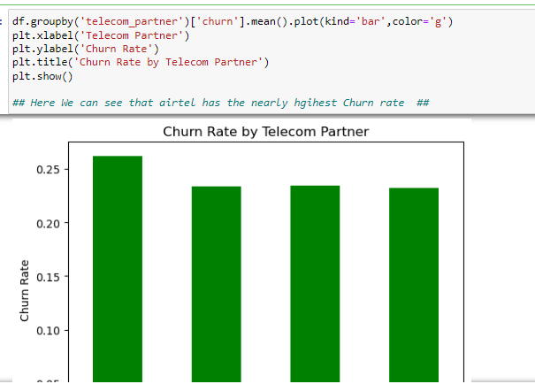
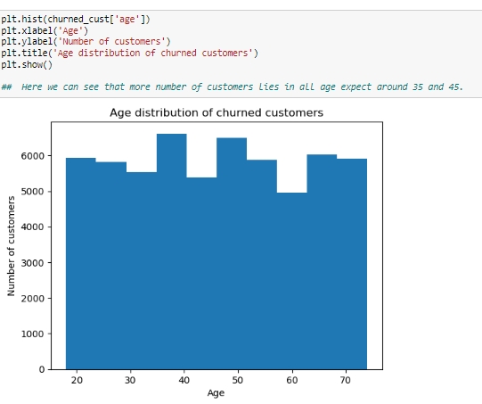
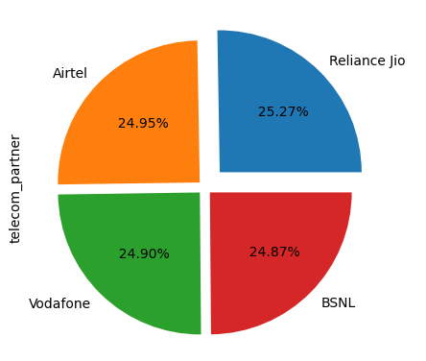
LEVEL 1 ANALYSIS –UNIVARIATE ANALYSIS
Here we can see that more number of customers lies in all age expect around 25,35 and 45 who have churned
Here We can see that airtel has the nearly highest Churn rate
Here we can see that higher number of customer in Reliance Jio

Slide 6
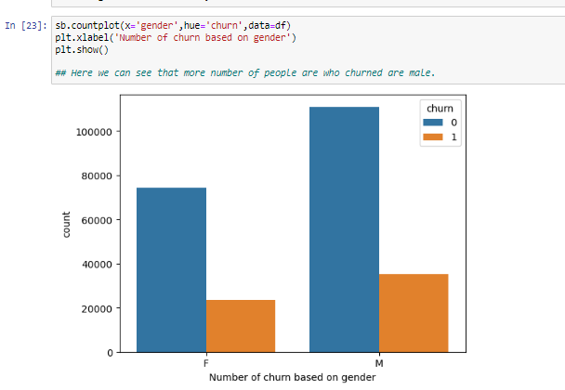
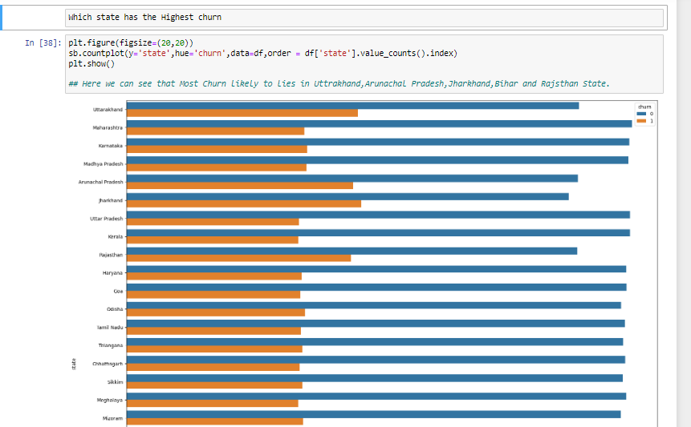
LEVEL 2 ANALYSIS – BIVARIATE ANALYSIS
Here we can see that more number of people are who churned are male.
Here we can see that Most Churn likely to lies in Uttarakhand, Arunachal Pradesh, Jharkhand, Bihar and Rajasthan State.

Slide 7
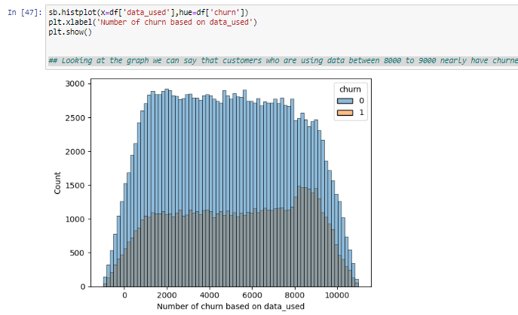
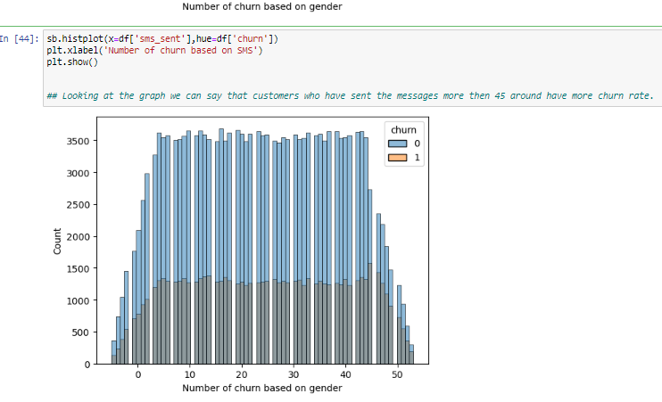
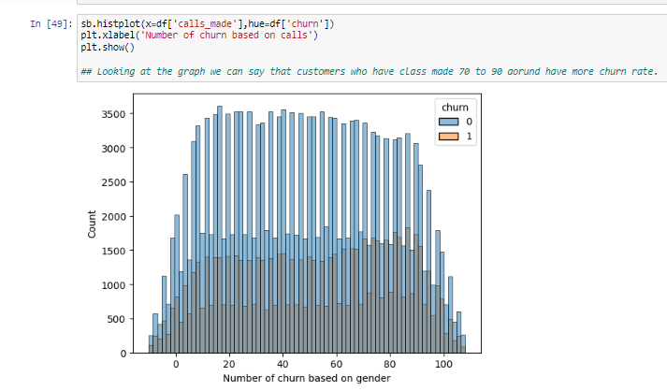
LEVEL 2 ANALYSIS – BIVARIATE ANALYSIS
Looking at the graph we can say that customers who are using data between 8000 to 9000 nearly have churned.
Looking at the graph we can say that customers who have sent the messages more then 45 around have more churn rate.
Looking at the graph we can say that customers who have class made 70 to 90 around have more churn rate.

Slide 8
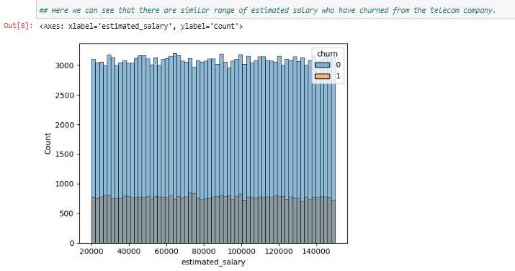
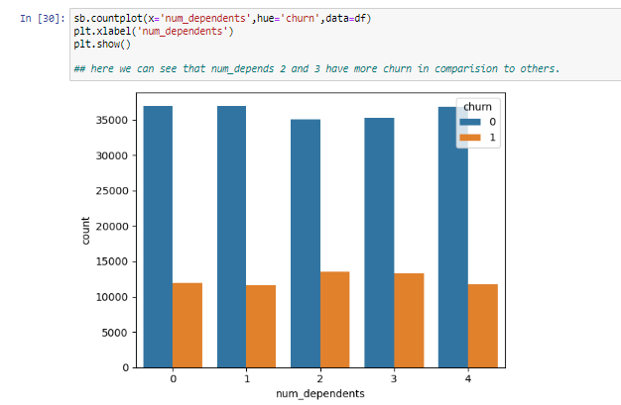
LEVEL 2 ANALYSIS – BIVARIATE ANALYSIS
Here we can see that there are similar range of estimated salary who have churned from the telecom company.
Here we can see that num_depends 2 and 3 have more churn in comparison to others

Slide 9
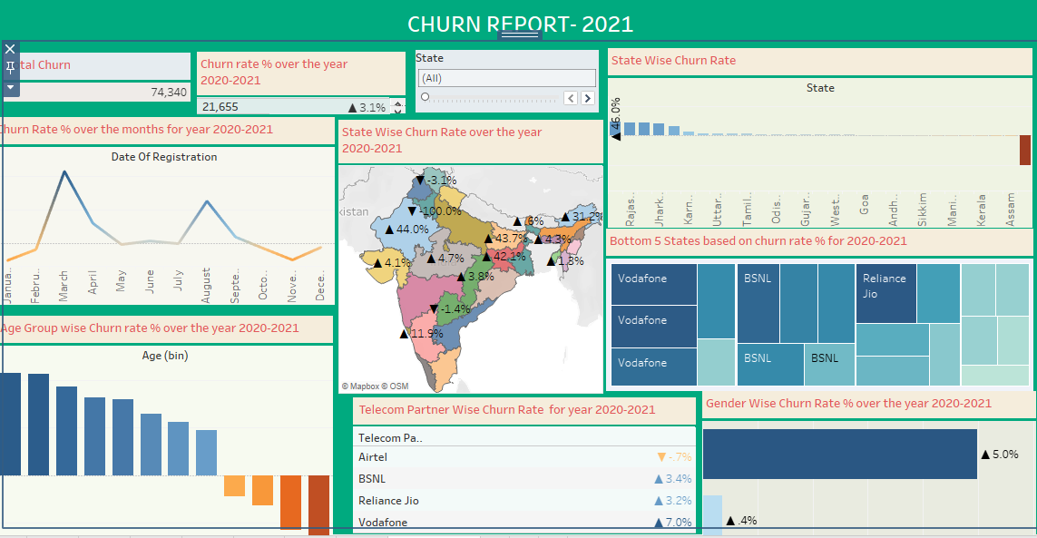
Tableau Dashboard based all questions
https://public.tableau.com/views/Simmi_Preplacement_Project_16956114290630/Dashboard1?:language=en-US&publish=yes&:display_count=n&:origin=viz_share_link
9

Slide 10


TRAI's suggestions to their telecom partners to reduce churn:
Airtel should offer more attractive and affordable plans to its customers.
Telecom partners should give special offers to customers who are high-usage users (e.g., calling more than 80 calls, sending more than 70 messages, and using more than 8000MB of data per month).
Telecom partners should focus on retaining customers in the 25-45 age range with 2-3 dependents.
Telecom partners should focus on reducing churn in the bottom 5 states (Uttarakhand, Arunachal Pradesh, Jharkhand, Bihar, and Rajasthan).
These suggestions are based on the analysis of churn data, which shows that these are the customer segments that are most likely to churn. By focusing on these segments, telecom partners can reduce their overall churn rate and improve their bottom line.
Conclusion
.

Slide 11




Thank you
Simmi

